Slide 1
Greate 30 March

Slide 2
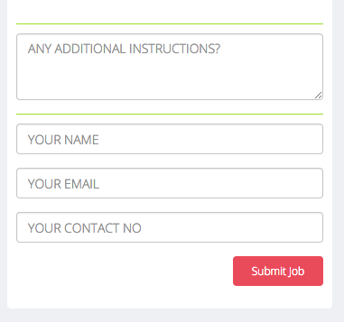
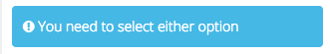
For all 3 quotation modules
Need error messages that appear below their respective fields
NAME – Oops… How should we address you!
EMAIL - Oops… you missed this!
CONTACT NO - Oops… don’t worry we won’t share this
Darn... our smallest size is 8x8 ft

Slide 3
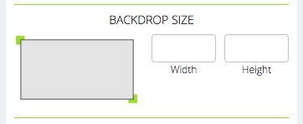
Error message placements
Add error message if user types in a size below 8x8 or nothing
Darn... our smallest size is 8x8 ft
Notes:
- It will show the error after you click submit job.

Slide 4
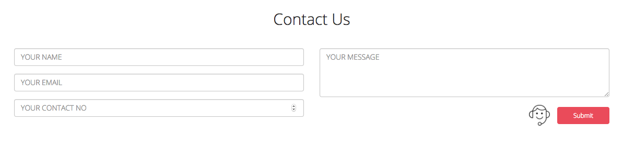
For the contact us field
Need error messages that appear below their respective fields
NAME – Oops… How should we address you!
EMAIL - Oops… you missed this!
CONTACT NO - Oops… don’t worry we won’t share this
Message – Don’t you want to ask something?

Slide 5
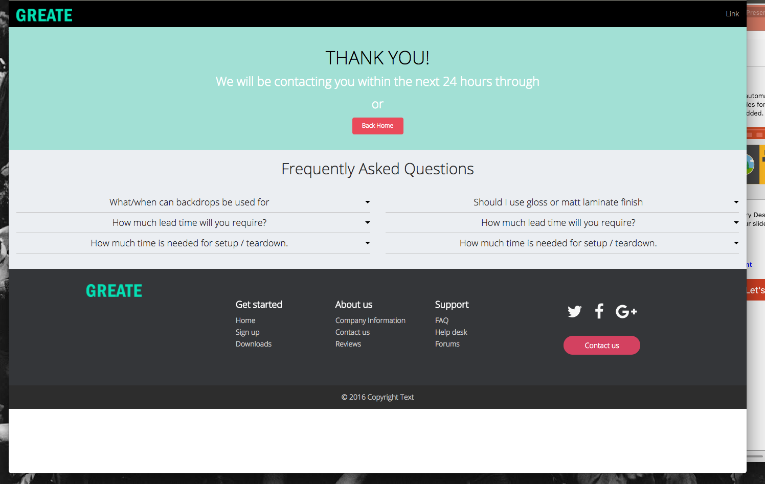
Thank you page on desktop has a bottom space.
The footer should be anchored down.
We can increase the height of the green portion.

